Slide 1

Course: CSCI 414/514 - Platform-Based Development
Members: CHIDUBEM OKOYE, Yvonne Onmakpo, Tonika Devi Avanigadda
Project Title: HuskyPark Predictor: AI-Driven Parking Spot Probability Dashboard for SCSU

Slide 2
Project Overview
Problem : Parking on campus
Solution : HuskyPark Predictor
Who benefits ?

Slide 3
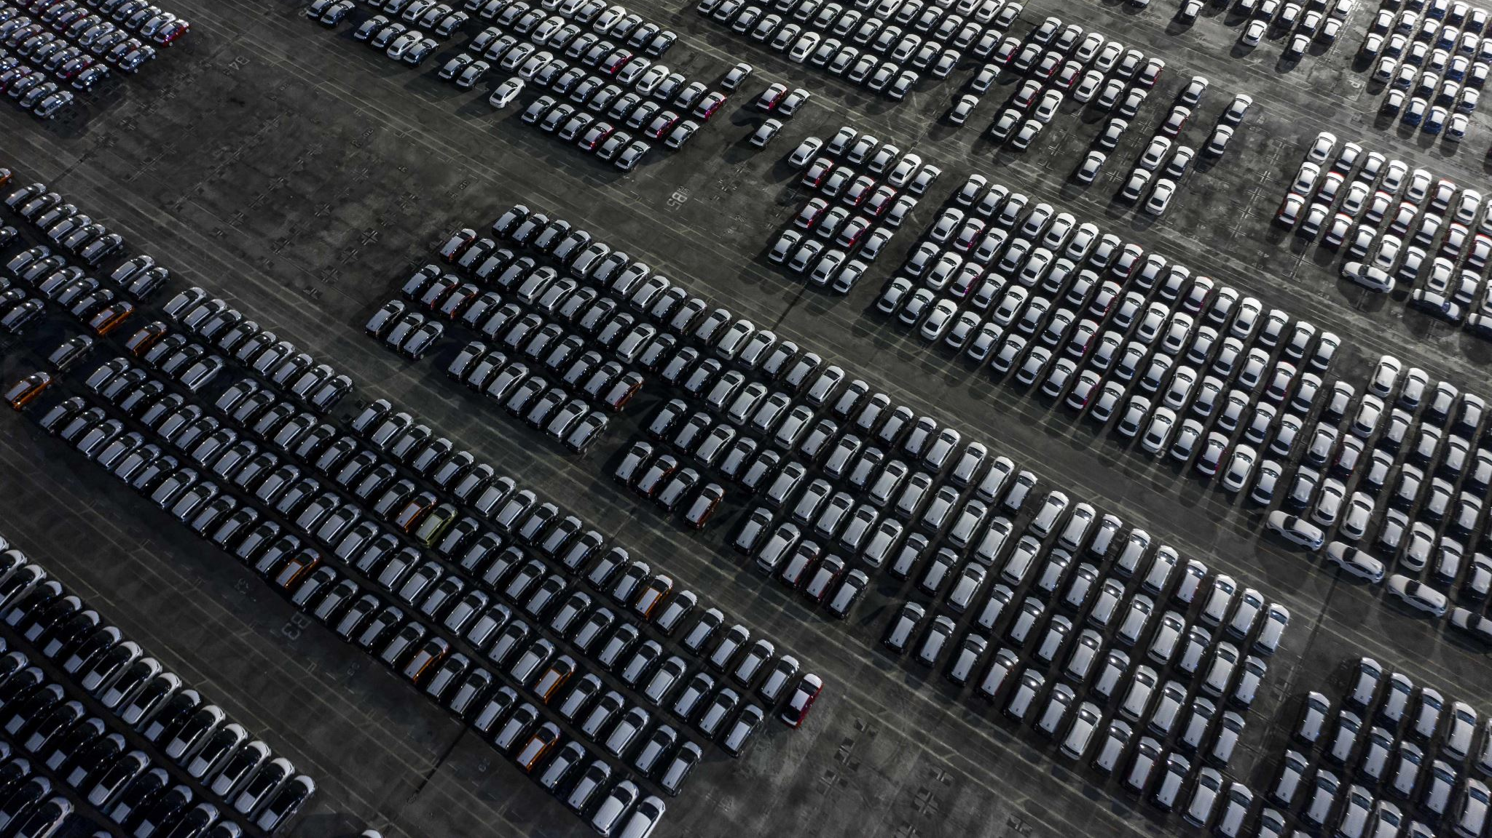
Problem Overview (Parking on Campus)
Parking at SCSU is inefficient and stressful
Students & staff waste time circling for parking
Peak hours = high demand, limited spots
Parking is fragmented across many lots (resident, commuter, employee, visitor)
External factors affect availability: Class schedules, Campus events, Minnesota weather
Impact: Late arrivals, Increased stress, Extra traffic & emissions

Slide 4

Solution: HuskyPark Predictor – Web Dashboard
A. Predicts probability of finding parking by:
Lots
Time of day
Day of week
Events & weather
B. Uses:
Historical patterns
Optional crowdsourced reports
C. Provides:
Best lot suggestions
Visual heatmaps
Real time probability estimates

Slide 5
Who Benefits ?
🎓 Students (residents & commuters)
🧑‍🏫 Faculty & staff
🧍 Visitors
🏫 University administration
🌆 Campus community

Slide 6

Motivation & Feasibility
Motivation * Real problem experienced by SCSU students * Supports smart campus initiatives * Improves efficiency and sustainability
Feasibility
* Web-based platform * Uses simulated + historical data * Achievable within course timeline

Slide 7
Innovation / uniqueness
AI driven probability predictions
Campus specific solution (SCSU)
Data visualization dashboard
Smart recommendation for users

Slide 8
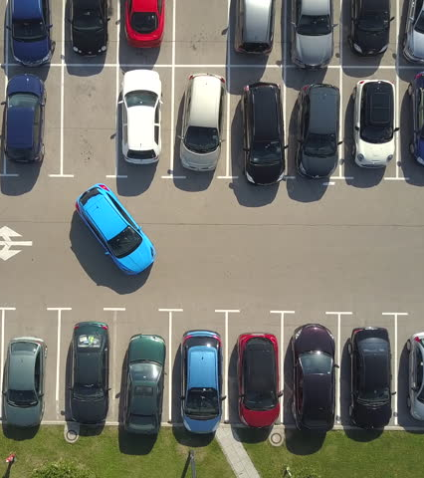
Expected outcomes
Functional parking probability dashboard
Visual analytics of parking trends
Improved user decision-making
Scalable smart campus platform concept

Slide 9
Conclusion
HuskyPark Predictor reduces parking stress at SCSU using probability-based guidance
Combines data and visualization to support faster parking decisions
Stage 1 deliverable: clear scope, feasibility, and team plan for implementation

